Slide 1
Theory of Elasticity in Geotechnical Engineering
Lecture
Hadush Seged (Dr.)
February 2, 2010

Slide 2
GRAVITY STRESSES, STRESS FUNCTIONS (contd.)
For a soil deposit with horizontal surface, we can at least find the vertical stress σ_{zz}. What if the surface is not horizontal?
The gravity stresses become a bit more complex and the solution involves the use of a tool called a stress function.
There are a number of stress functions in the theory of elasticity. The well-known Airy stress function will be considered here (developed by British mathematician George B. Airy in 1862).
Besides, only plane strain problem will be considered here.

Slide 3



For plane strain problem, the strains in one direction will all be zero. If we take this to be the y-direction , then:
...(10.1)
and the nonzero strains ε_{xx}, ε_{zz}, ε_{xz} = ε_{zx} will not be functions of y.
Hooke’s law then shows that the only nonzero stresses are:
Besides, the fact that ε_{yy} = 0, shows that:
Hence, only three independent stress components fully describe a plane strain stress field: σ_{xx}, σ_{zz}, and σ_{xz} .

Slide 4
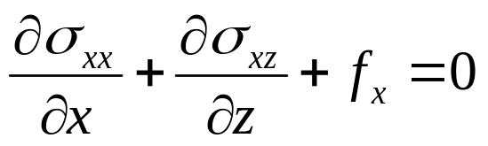

For plane strain condition, the equilibrium equations become:
...(10.2)
The body forces f_{x} and f_{z} account for self weight of the soil. For a horizontal ground surface, the component f_{z} becomes –ρg, and the value of f_{x} is zero.

Slide 5






Zero tractions
For a more general situation (Fig. 10.1) f_{x} and f_{z} are given by:
...(10.3)
Gravity
FIG. 10.1: Gravity stress: sloping ground surface.
A convenient way to represent the effects of gravity in the equilibrium equation is to introduce a potential function V = V(x, z). Let,

Slide 6

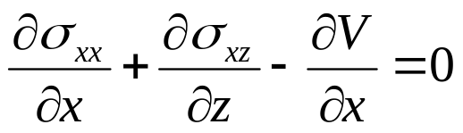




...(10.4)
Then, equation (10.2) can be written as:
...(10.5)
For plane strain condition, Hooke’s law (equations 6.5 & 6.6 …lecture 6) can be written as:
...(10.6)

Slide 7
SAINT VENANT COMPATIBILITY EQUATIONS
The strain-displacement relations (in Eqn. 4.24 or the index notation form, eqn. 4.25..lecture 4) represent six equations for the six strain components in terms of three displacements.
If we were given continuous, single-valued displacements u, v, w, then it would be easy to use eqn. (4.24) to find the strain components.
However, the converse is not necessarily true; that is, given the six strain components, integration of the strain-displacement relations (4.24) does not necessarily produce continuous, single-valued displacements.

Slide 8
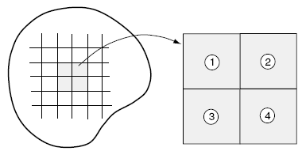
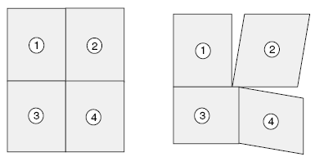
In order to ensure continuous displacements, the strains must satisfy additional relations called integrability or compatibility equations.
Fig. 10.2 shows geometric interpretation of strain compatibility.
Discretized
Elastic Solid
Undeformed
Configuration
Continuous
Displacements
Discontinuous Displacements
FIG. 10.2: Physical interpretation of strain compatibility.

Slide 9
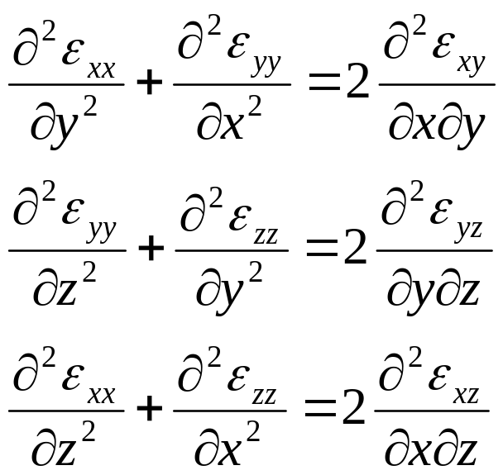
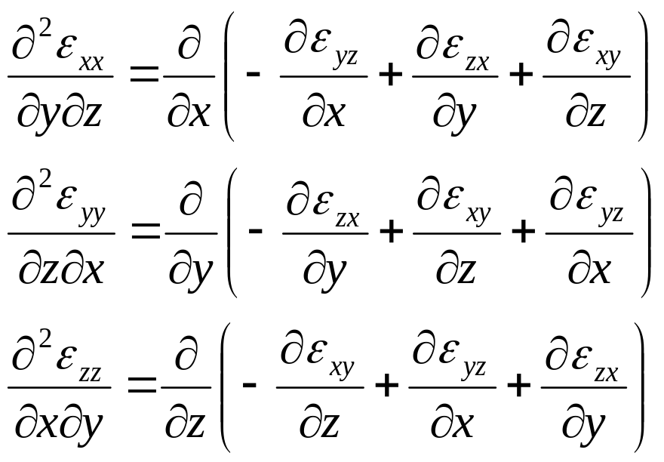
The whole problem was solved by the great French mathematician Barre de Saint-Venant in 1860. Saint-Venant showed that the strain components must satisfy the following six differential equations.
...(10.7)

Slide 10
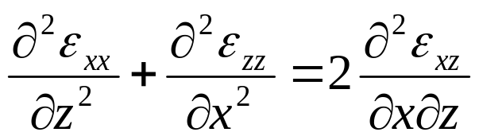
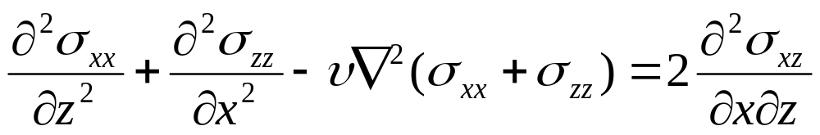
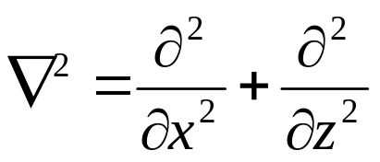
For plane strain condition, only the third equation is not automatically satisfied.
...(10.8)
Using equation (10.6…slide 6) in (10.8), we get:
...(10.9)
here
is the two-dimensional Laplacian operator.

Slide 11
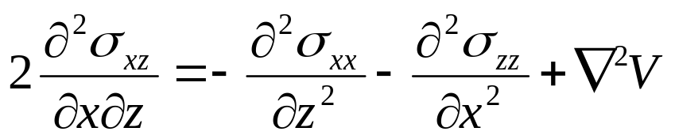
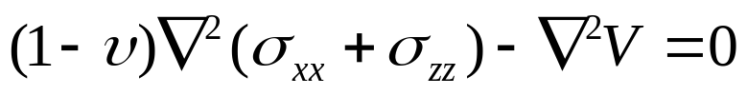
Now if we differentiate the first of the equilibrium equations (10.5…slide 6) with respect to x and the second with respect to z and add the resulting equations, we find:
...(10.10)
Using equation (10.10) in (10.9), we get:
...(10.11)
We have now three equations, (10.5) and (10.11), to solve for the three unknowns σ_{xx}, σ_{zz}, and σ_{xz}.

Slide 12
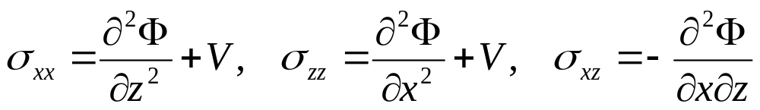
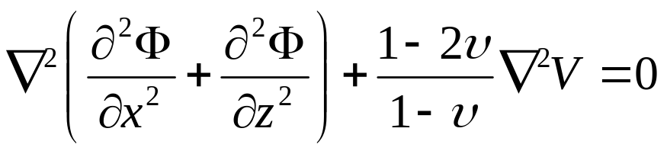

How do we find the solution? Airy suggested we consider a function Φ = Φ(x, z) constructed in such a way that:
...(10.12)
The above relations satisfy the equilibrium equations (10.5).
Using the first two of (10.12) in (10.11), we get:
...(10.13)
Since V is linear function of x and z,

Slide 13


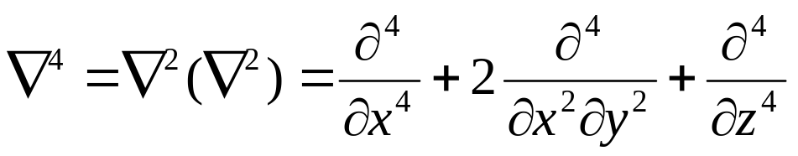
Thus, equation (10.13) reduces to:
...(10.14)
Where is called the biharmonic operator, and is defined by:
...(10.15)
Any function that satisfies the biharmonic equation (10.14), offers a possible solution.
The stresses determined from (10.12) will satisfy both equilibrium and compatibility. If the stresses also satisfy the given boundary conditions, then we have a particular solution.

Slide 14

Now in order to solve the gravity stresses in the sloping deposit, we should first find an Airy stress function.
Any function we propose must first satisfy the biharmonic equation (10.14) and must produce stresses that satisfy the boundary conditions .
The only boundary condition we have here is that the ground surface is traction-free. That is,
...(10.16)

Slide 15
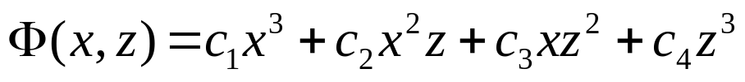
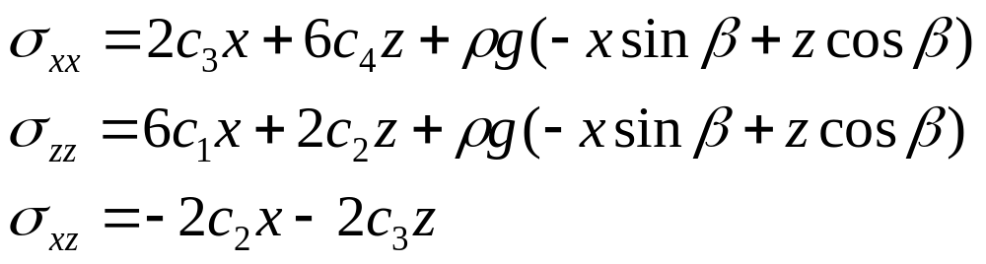
There are a number of functions that will automatically satisfy (10.14). The simplest are all polynomials in x and z of degree three or less.
Suppose we try a polynomial such as:
...(10.17)
Using (10.17) in (10.12…slide 12), we find:
...(10.18)

Slide 16


These stresses should also satisfy the boundary condition. Setting z = 0 and from (10.16), we have:
Using this in (10.18) we have σ_{xx} unchanged and:
...(10.19)
Equation (10.18) implies that if x becomes very large, σ_{xx} could grow without bound. But since we would like to have finite stresses only, it is reasonable to require σ_{xx} not depend up on x.

Slide 17
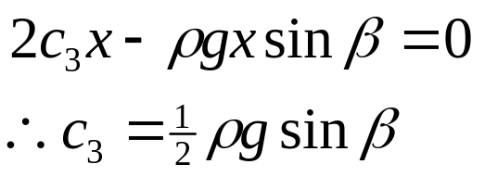
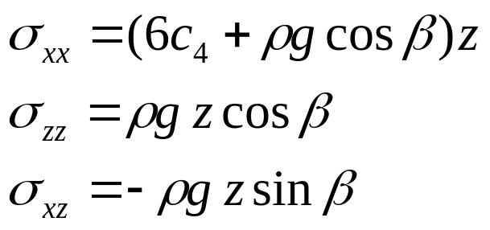
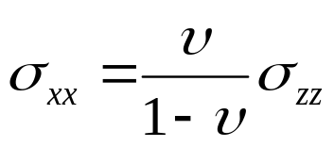
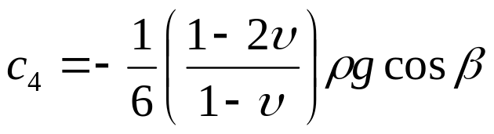
This implies that:
The stresses are now:
...(10.20)
c₄ remains unknown. But if we were to assume ε_{xx}= 0 as we did for the horizontal ground surface, then (10.6…slide 6) shows that:
and

Slide 18
APPLICATIONS OF FUNDAMENTAL SOLUTIONS
In this section, we will see how the fundamental solutions (especially Boussinesq's) can be used to analyze the stresses and displacements caused by shallow structural foundations.
The simplest problems involve a uniform vertical stress applied at the surface of a homogeneous, isotropic, elastic half-space. For stress area of regular geometric shape, such as a circle or a square, the problem is further simplified.
Generally, we can fully determine most of the stresses and displacements simply by integrating Boussinesq’s fundamental equations over the region covered by the load.

Slide 19

Uniform Circular Load on Homogeneous Half-space
This is the simplest possible application. An example is analysis of a liquid storage tank like that shown in Figure 10.4
FIG. 10.3: Liquid storage tank
The problem can be represented as a vertical pressure p₀ applied uniformly over the circular region R of radius a as shown in Figure 10.4.

Slide 20
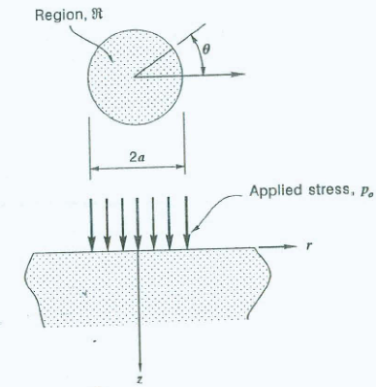
FIG. 10.4: uniform stress p₀ applied over a circular region

Slide 21
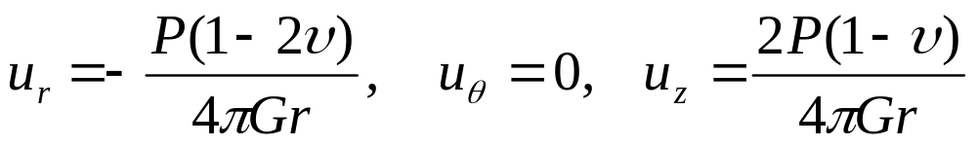

Referring back to eqns. (8.12…lecture 8), the displacements on the surface z = 0 for the vertical point load are:
...(10.21)
The vertical settlement on the surface is usually the most interesting quantity in foundation analysis.
Now the applied load P should be replaced by the applied stress p₀ multiplied by an element of area dA.
Consider the point exactly under the center of the tank, then

Slide 22
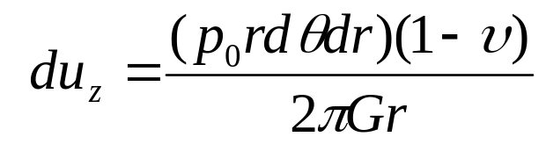
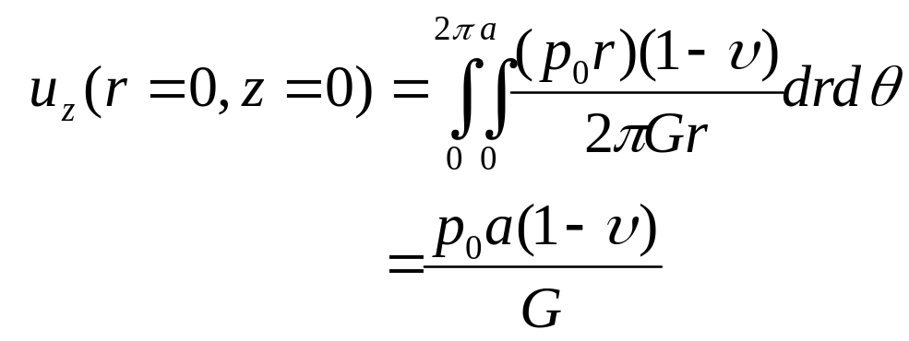
The contribution to the vertical displacement u_{z}, at this point is:
...(10.22)
Integrating both sides of this equation, we find:
...(10.23)
Eqn. (10.23) gives the surface settlement at the center of any uniform circular load.

Slide 23






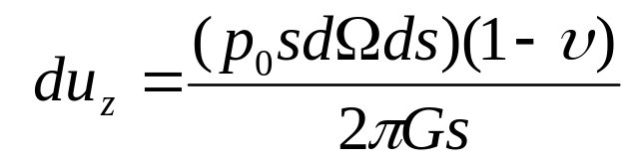

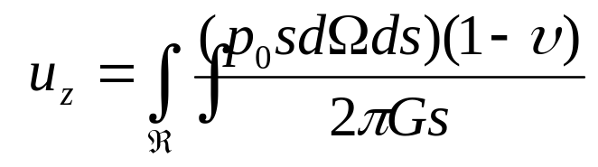
consider the vertical displacement at the edge of the circular load.
The contribution to the vertical displacement u_{z}, at this point is:
Integrating both sides:
FIG. 10.5: geometry for finding displacement at edge of loaded region

Slide 24
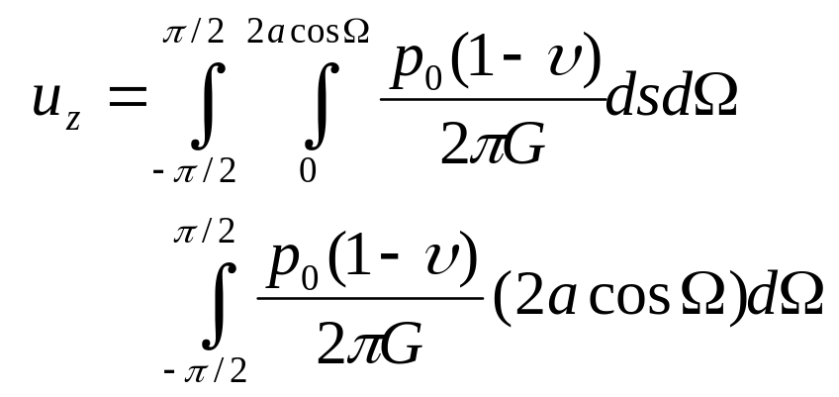
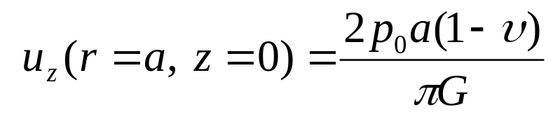
The limits of integration for Ω are –π/2 to π/2, while s varies between 0 and 2acosΩ.
...(10.24)
This is less than the displacement at the center by a factor of 2/π.

Slide 25





Uniform Loads of other Shapes, Homogeneous Half-space
Consider the triangular-shaped load with constant magnitude p₀ (Fig. 10.6). This is a right triangle and two sides are aligned with the x- and y-axes.
We will first find the vertical settlement w beneath the corner of the triangle marked A.
FIG. 10.6: triangular loaded region
The point load here will be p₀dxdy and the contribution to the vertical settlement w will be:

Slide 26
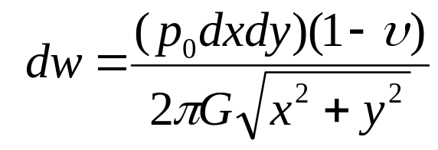
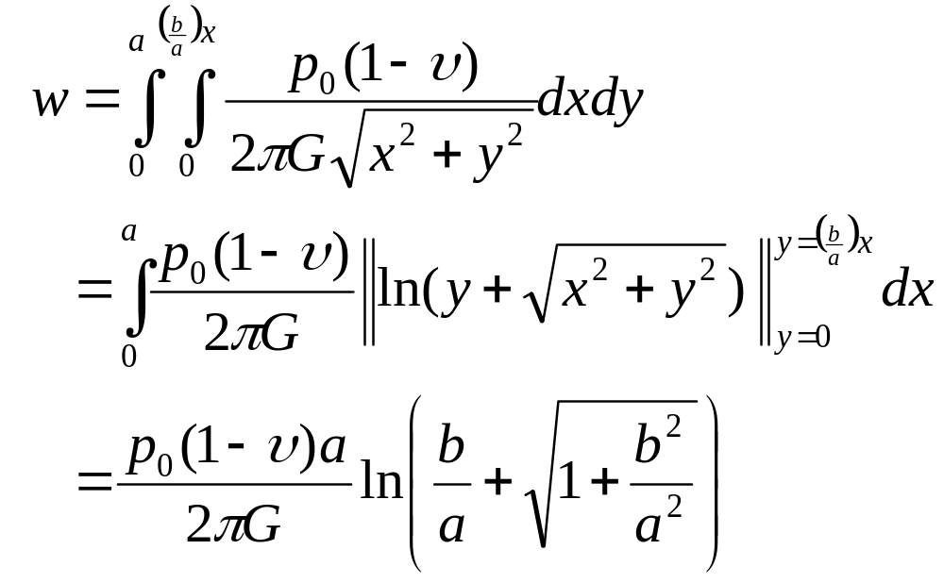
...(10.25)
Integrating both sides of this equation:
...(10.26)

Slide 27
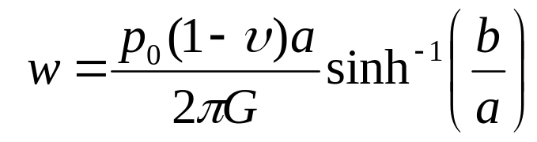
Equation (10.26) can be written in another form:
...(10.27)
There may not be many real life applications for the right triangle loading. But we can use the right triangular region so effectively to build up, using superposition, a great range of other shapes.
For example, to find the settlement beneath one corner of a rectangular load, we just need to put together two triangles, as in Fig. 10.7. The settlement at A will consist of two parts:

Slide 28



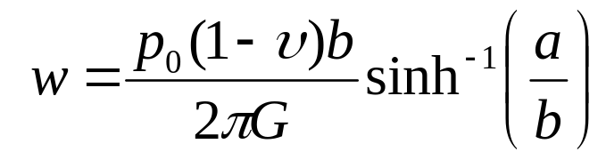
where w_{l} is settlement due to triangle 1:
FIG. 10.7: Superposition of two triangular loads to create a rectangular loaded region
where w₂ is settlement due to triangle 2:

Slide 29
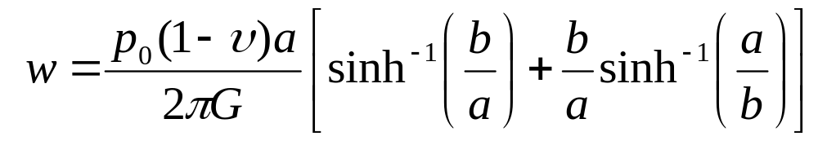
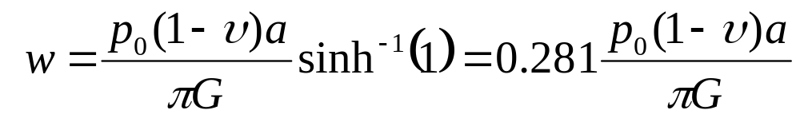
Putting together the two parts:
...(10.28)
For the special case of a square, set a = b, then:
...(10.29)

Slide 30





FIG. 10.8: Using superposition to find the settlement at a point exterior to a rectangular load.

Slide 31
Non- uniform Loads, Homogeneous Half-space
Non-uniform loads arise due to stresses that are functions of position.
Here p₀ will be replaced by p(x, y), a function of x, y over some region R. The only difference from the previous examples is that the elemental point load p(x, y) may possibly complicate the integrations.
As an example, consider the parabolic stress distribution applied over a circular region (Fig 10.9). The applied stress is given by:

Slide 32
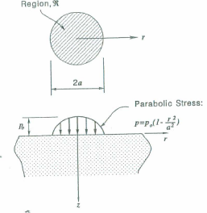
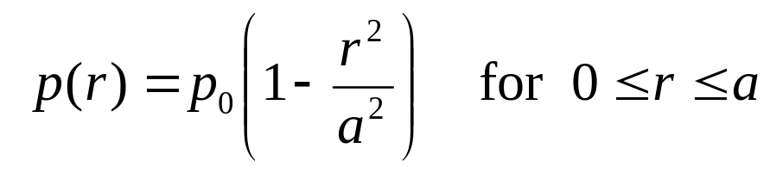
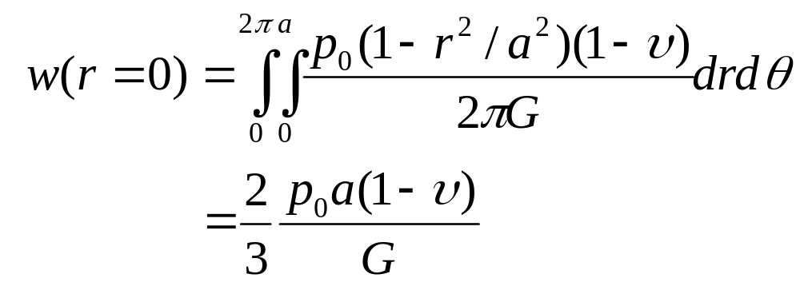
the surface displacement beneath the center of the load can be determined as:
...(10.30)
FIG. 10.9: Parabolic stress distribution over a circular region

Slide 33
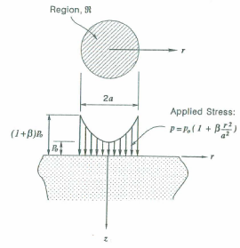
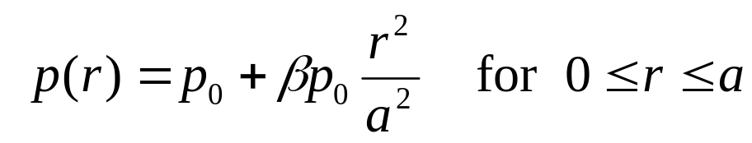
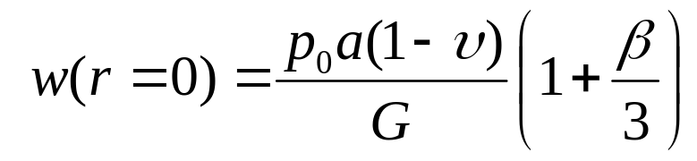
Another example is the inverted parabolic stress distribution (Fig. 10.10). The applied stress is specified by:
the surface displacement beneath the center of the load will be:
...(10.31)
FIG. 10.10: Inverted parabolic stress distribution over a circular region.

